Slide 1


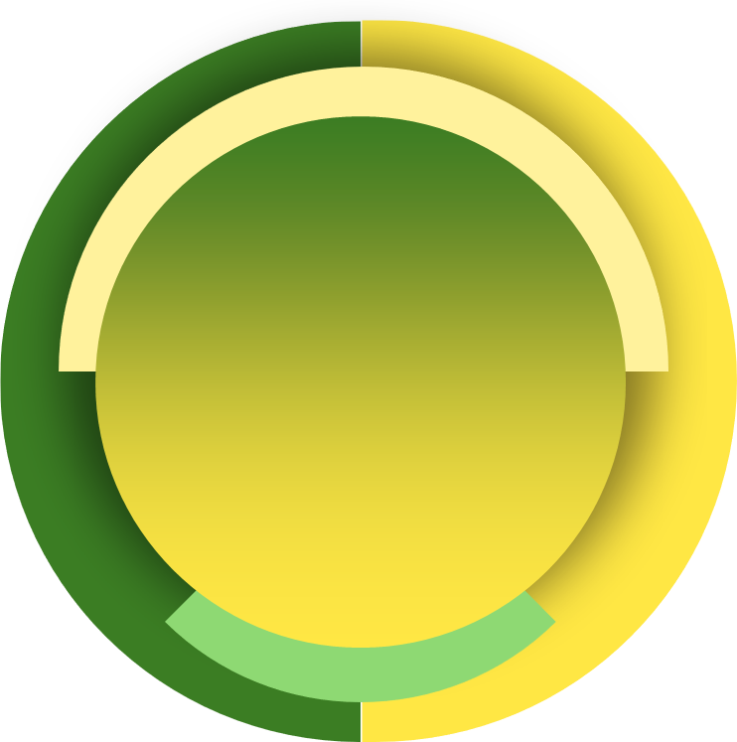
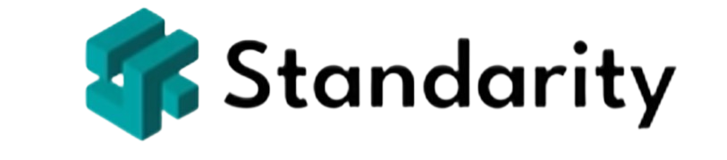
Step 1 - Define the Purpose and Objectives of Your Helpdesk
Understand What an IT Helpdesk Does
Identify the core responsibilities and services provided by an IT Helpdesk.
Define Helpdesk Goals
Align helpdesk objectives with organizational needs
Practical Exercise
Write a mission statement and key objectives for your IT Helpdesk.
Build Your IT Helpdesk - Step by Step
Notes:
In this step, we are going to lay the foundation for building an efficient and effective IT Helpdesk by clearly defining its purpose and objectives. Understanding the core responsibilities and aligning them with organizational goals is essential for creating a helpdesk that meets user needs and supports broader business strategies.
First, we’ll explore What an IT Helpdesk Does by identifying its key responsibilities and the services it provides. You’ll gain clarity on the role of the helpdesk as the central point for IT support, resolving incidents, managing requests, and enabling smooth technology operations across the organization.
Next, we’ll move on to Defining Helpdesk Goals. This involves aligning the helpdesk’s objectives with the needs of your organization. For example, you might focus on reducing downtime, improving user satisfaction, or streamlining workflows. Setting clear goals ensures that the helpdesk’s efforts contribute directly to organizational success.
To reinforce these concepts, we’ll write a mission statement and define key objectives for a IT Helpdesk. This exercise will help us apply what you’ve learned and set the vision for a user-centric and efficient helpdesk.

Slide 2
Understand What an IT Helpdesk Does
Core Responsibilities / Services | Description
Incident Management | Logging, tracking, and resolving technical issues reported by users.
Service Request Fulfillment | Handling user requests for new services or resources.
User Support | Providing assistance and guidance on IT-related queries and issues.
Problem Management | Identifying and addressing the root causes of recurring incidents.
Knowledge Management | Creating and maintaining documentation and knowledge base articles.
Communication | Keeping users informed about issue statuses and system updates.
Access Management | Managing user access rights and permissions for systems and applications.
Reporting and Metrics | Tracking performance indicators to improve service quality.
Build Your IT Helpdesk - Step by Step
Notes:
An IT Helpdesk serves as the frontline support system within an organization, acting as the primary liaison between the IT department and the end-users.
One of its core responsibilities is Incident Management, which involves logging, tracking, and resolving technical issues reported by users. This process ensures that disruptions are minimized and that users can resume their work promptly.
In addition to handling incidents, the helpdesk is responsible for Service Request Fulfillment. This entails processing requests for new services or resources, such as setting up new hardware, installing software applications, or granting access to specific systems. By efficiently managing these requests, the helpdesk helps maintain operational continuity.
Providing User Support is another essential service. Helpdesk staff assist users by answering IT-related queries, offering guidance on software and hardware usage, and troubleshooting common problems. This support fosters a more tech-savvy workforce and reduces downtime caused by user errors.
Through Problem Management, the helpdesk team identifies and addresses the root causes of recurring incidents. By analyzing patterns in incident reports, they can implement solutions that prevent future issues, thereby enhancing system reliability and performance.
The helpdesk also plays a pivotal role in Knowledge Management. By creating and maintaining a repository of documentation—such as FAQs, how-to guides, and troubleshooting articles—they empower users to find answers independently. This resource not only speeds up problem resolution but also reduces the volume of incoming helpdesk tickets.
Effective Communication is crucial for managing user expectations and maintaining transparency. The helpdesk keeps users informed about the status of their issues, scheduled maintenance, and any system outages or updates. Timely communication helps build trust and reduces frustration among users.
Access Management is another critical function, involving the administration of user permissions and access rights to various systems and applications. By controlling access, the helpdesk helps safeguard sensitive information and ensures compliance with security policies.
Finally, the helpdesk is responsible for Reporting and Metrics. By tracking key performance indicators such as response times, resolution rates, and customer satisfaction scores, they can identify areas for improvement. Regular analysis of these metrics enables the helpdesk to enhance service quality and efficiency continually.

Slide 3
Define Helpdesk Goals
Helpdesk Goal | Organizational Need Addressed | Description
Reduce Downtime | Improve Productivity | Minimize system outages to ensure employees can work without interruptions.
Enhance Customer Satisfaction | Increase User Trust and Retention | Provide timely and effective support to improve user experience and satisfaction levels.
Streamline Support Processes | Operational Efficiency | Optimize workflows to handle requests efficiently, reducing response and resolution times.
Improve First Contact Resolution | Cost Reduction | Resolve issues during the first interaction to minimize escalations and repeated contacts.
Implement Proactive Support Measures | Preventative Maintenance | Anticipate and address potential issues before they impact users, reducing reactive incidents.
Ensure Compliance and Security | Regulatory Compliance | Adhere to data protection laws and security protocols to safeguard organizational data.
Foster Continuous Improvement | Innovation and Growth | Regularly update processes and technologies to adapt to changing business needs.
Promote Self-Service Usage | Empower Users | Encourage users to utilize self-service tools to solve simple issues independently.
Support Strategic Business Goals | Business Alignment | Align helpdesk initiatives with the organization's long-term objectives and projects.
Build Your IT Helpdesk - Step by Step
Notes:
Setting clear and strategic goals for your IT Helpdesk is essential for ensuring that it not only resolves technical issues but also contributes significantly to your organization's overall success. By aligning helpdesk objectives with the broader organizational needs, you create a support system that enhances productivity, efficiency, and user satisfaction.
One of the primary goals is to Reduce Downtime, directly impacting the organization's need to Improve Productivity. By minimizing system outages and ensuring that technical issues are resolved swiftly, employees can perform their tasks without unnecessary interruptions. This seamless operation boosts overall efficiency and contributes to meeting business targets.
Enhancing Customer Satisfaction addresses the need to Increase User Trust and Retention. Providing timely and effective support improves the user experience, fostering a positive perception of the IT department and the organization as a whole. Satisfied users are more likely to remain loyal and advocate for the company's services or products.
Streamlining Support Processes is aimed at achieving Operational Efficiency. By optimizing workflows and eliminating bottlenecks in ticket handling, the helpdesk can reduce response and resolution times. Efficient processes enable the support team to handle a higher volume of requests without compromising on quality, thereby maximizing resource utilization.
Improving First Contact Resolution rates contributes to Cost Reduction. Resolving issues during the initial interaction reduces the need for escalations and follow-up communications, saving time and resources. This efficiency not only cuts operational costs but also enhances user satisfaction by providing immediate solutions.
Implementing Proactive Support Measures aligns with the need for Preventative Maintenance. By anticipating potential technical issues through regular system monitoring and updates, the helpdesk can address problems before they affect users. This proactive approach reduces the frequency of incidents and maintains a stable IT environment.
Ensuring Compliance and Security meets the organizational need for Regulatory Compliance. The helpdesk must adhere to data protection laws and internal security protocols to safeguard sensitive information. This commitment to security protects the organization from legal risks and reinforces trust with clients and stakeholders.
Fostering Continuous Improvement addresses the need for Innovation and Growth. The IT Helpdesk should regularly review and update its processes, technologies, and skill sets to adapt to evolving business needs and technological advancements. This culture of improvement keeps the organization competitive and responsive to market changes.
Promoting Self-Service Usage empowers users and aligns with the goal of Empowering Users. By encouraging the use of self-service portals and knowledge bases, users can resolve minor issues independently. This not only reduces the volume of support tickets but also fosters a more knowledgeable and self-reliant user base.
Finally, supporting Strategic Business Goals ensures Business Alignment. The helpdesk should align its initiatives with the organization's long-term objectives, such as digital transformation projects or customer experience enhancements. By doing so, the helpdesk becomes a strategic partner in achieving business success rather than just a reactive support function.

Slide 4

Our Use Case: TechGear Solutions
Industry: Technology (hardware and software development).
Size: 500 employees across multiple locations.
Challenges: Growing support needs, lack of workflows.
Goals: Reduce downtime, improve user satisfaction.
Focus Areas: Incident management, self-service, performance tracking.
Outcome: Scalable, efficient IT Helpdesk for diverse needs.
Build Your IT Helpdesk - Step by Step
Notes:
In order to make this course practical and realistic, we use a model company, TechGear Solutions, as a continuous example throughout the lessons.
TechGear Solutions is a mid-sized technology firm that specializes in developing custom hardware and software solutions.
With around 500 employees and operations spanning multiple offices and remote teams, the company faces typical challenges such as managing growing IT support demands, ensuring operational efficiency, and maintaining high user satisfaction. By following the journey of TechGear Solutions, you will see how each step of building and managing an IT Helpdesk is applied in a real-world context.
The IT Helpdesk at TechGear Solutions is designed to serve as the central point of contact for all IT-related issues. It handles a range of services, from resolving incidents and managing service requests to creating a knowledge base and tracking performance metrics. Throughout the course, you’ll see how the helpdesk evolves to address specific challenges such as slow response times, lack of standardized workflows, and the need for proactive problem management. This use case not only demonstrates the practical application of the concepts taught but also provides a framework you can adapt to your organization.
By the end of the course, you’ll have followed TechGear Solutions through each stage of developing an IT Helpdesk, from defining its purpose to scaling for future growth. This step-by-step example ensures that the lessons are relatable, actionable, and aligned with real-world scenarios, giving you the confidence to apply them effectively in your role.

Slide 5

Write a Mission Statement
Defines core purpose and objectives of Helpdesk.
Provides reliable, efficient, user-centric IT support.
Empowers employees to enhance productivity and focus.
Delivers prompt and effective IT assistance.
Resolves issues with professionalism and empathy.
Promotes self-service for faster issue resolution.
Ensures compliance and safeguards data integrity.
Aligns support services with organizational goals.
Build Your IT Helpdesk - Step by Step
Notes:
A mission statement defines the core purpose and objectives of the IT Helpdesk, providing clear direction and aligning its services with organizational goals.
At TechGear Solutions, the mission of our IT Helpdesk is to provide reliable, efficient, and user-centric IT support that empowers employees and enhances productivity across the organization. We strive to create a seamless and secure technology experience, enabling our team members to focus on delivering exceptional hardware and software solutions to our clients. The helpdesk is dedicated to being a strategic partner that drives innovation, fosters collaboration, and ensures operational excellence as the company continues to grow.
Our commitment begins with delivering prompt and effective assistance for all IT-related needs, ensuring employees can quickly overcome technical challenges.
By maintaining high levels of employee satisfaction, we aim to resolve issues with empathy and professionalism, fostering trust and a positive support experience. The helpdesk continuously enhances its processes and tools to stay aligned with TechGear’s goals for growth and innovation, ensuring our support evolves with the company’s dynamic needs.
To empower our users, we promote self-service resources that enable employees to address common issues independently, reducing downtime and fostering self-reliance.
Additionally, we uphold the highest standards of security and compliance, safeguarding company assets, intellectual property, and data integrity in every interaction.
At its core, the IT Helpdesk at TechGear Solutions is designed to be more than just a support function. It is a key driver of the organization’s mission to innovate and excel, ensuring our IT infrastructure and support services align seamlessly with our broader business objectives.

